Slide 1
Chapter 3 Data Organization
in Computer Programs
Dr. Le Thanh Sach
Notes:
1
1

Slide 2
Content
Data and Data Types
Keywords
Variable and Variable Declaration
Scope
Operators and Expressions
Enum Data Type
Constant Definition
Type Casting
Exercises
Notes:
2

Slide 3
Data and Data Types
Why do we need data types ?
Every program need data for its processing
Example:
A simple program
=> Need a place to store data (“LAP TRINH C/C++”) to print to console
int main(){
cout << “LAP TRINH C/C++”;
return 0;
}
Notes:
3

Slide 4
Data and Data Types
Why do we need data types ?
Every program need data for its processing
Example:
A program to solve quadratic equation
Data:
Coefficient A,B,C of quadratic equation
Delta
Solution of the equation
Human resources management application
Data:
Identifier, name, salary, etc,....
Notes:
4

Slide 5
Data and Data Types
Why do we need data types ?
Every program need data for its processing
Programmer needs memory (in RAM) to store data while application is running
When users input data (use keyboard, touch on screen, read from sensor,etc..): data will be saved in the memory of RAM
Example: Read coefficients A,B,and C of quadratic equation from keyboard
During the running: memory is read and processed.
Example: To calculate DELTA in quadratic equation, coefficients will be read and used to find DELTA by using this formula (DELTA = B*B – 4*A*C;)
Notes:
5

Slide 6
Data and Data Types
Data Types
Describe the data to be processed by programs
It specifies:
What kind of data can be stored into a variable
How many bits of the area should be allocated for a variable
Which operators can be applied with the variable
…
Notes:
6

Slide 7
Data and Data Types
Data Types
Character
Boolean: True/False
Number
Integer
Float
String: “LAP TRINH C/C++”
An array of values
Union containing any one of several objects of various types (struct, class)
Enumerated data associated with integers (enum)
…
Notes:
7

Slide 8
Data and Data Types
How programming languages can distinguish these data types ?
C/C++ language (or other languages) defines the meaning of each data type provided by compiler
These data types are called fundamental data types
These build-in data types are used by using keywords. Programmer should not use these keywords to name other data types or function,....
Notes:
8

Slide 9
Data and Data Types
Data types
Fundamental data types
Name of type is keyword
Meaning of these types defined by programming languages
User-defined data type
Defined by programmer
Meaning of these types defined by programmer based on:
Other user-defined data types
Fundamental data types
Some popular data types in C/C++
C: struct, enum
C++: class
Notes:
9

Slide 10
Data and Data Types
Data types
Fundamental data type
User-defined data type
Derived data type
C/C++ provided symbols to create new data types (based on fundamental or user-defined data types)
Example:
Array
Array of characters, numbers (integer or float), etc...
Pointer
A pointer to a string, a number or an object,....
Notes:
10

Slide 11
Data and Data Types
Fundamental data types
Type | Keyword | Size | Value
Typeless | void | 1 byte
Character | char | 1 byte | ‘a’, ‘\n’
Boolean | bool | 1 byte | True, false
Real number
(1) | float | 4 bytes | 1.5f, 100f
(2) | double | 8 bytes | 1.5, 100
(3) | long double | 12 bytes | 1.5l, 100l
Notes:
11

Slide 12
Data and Data Types
Fundamental data types
Type | Keyword | Size | Value
Integer number
(1) | char, signed char | 1 byte | -2, 0, 4
(2) | unsigned char | 1 byte | 0, 1, 255
(3) | short int, signed short int, short, signed short | 2 bytes | 10, -100
(4) | unsigned short int, unsigned short | 2 bytes | 0, 15, 100
(5) | int, signed int, long int, signed long int, long, signed long | 4 bytes | 10, -100
(6) | unsigned int, unigned long int, unsigned long | 4 bytes | 0, 15, 100
(7) | long long int, signed long long int | 8 bytes | 10, -100
(8) | unsigned long long int | 8 bytes | 0, 15, 100
Notes:
12

Slide 13
Data and Data Types
Fundamental data types
(*) Number of bytes depends on compilers, but will satisfy the following constraints:
1 == sizeof(char) <= sizeof(short) <= sizeof(int)
<= sizeof(long) <= sizeof(long long)
Should use “sizeof” to get the size of a data type!
Notes:
13

Slide 14
Data and Data Types
A program print number of bytes of each data type
Function: sizeof(.) return number of bytes of a type
#include <iostream>
#include <iomanip>
using namespace std;
int main(){
//bool
cout << "sizeof(bool) = " << setw(3) << sizeof(bool) << endl;
//char
cout << "char:" << endl;
cout << "sizeof(char) = " << setw(3) << sizeof(char) << endl;
cout << "sizeof(signed char) = " << setw(3) << sizeof(signed char) << endl;
cout << "sizeof(unsigned char) = " << setw(3) << sizeof(unsigned char) << endl;
//short
cout << "short:" << endl;
cout << "sizeof(short) = " << setw(3) << sizeof(short) << endl;
cout << "sizeof(signed short) = " << setw(3) << sizeof(signed short) << endl;
cout << "sizeof(unsigned short) = " << setw(3) << sizeof(unsigned short) << endl;
system("pause");
return 0;
}
Notes:
14

Slide 15
Data and Data Types
Further reading
Typedef
Notes:
15

Slide 16
Keywords
What are keywords ?
Are words with the special meaning defined by programming language
Example: name of fundamental data types
Programmer is not allowed to use keywords to name variable, function, constant,etc,...
Notes:
16

Slide 17
Keywords
Keywords in C++
auto | double | int | struct
break | else | long | switch
case | enum | register | typedef
char | extern | return | union
continue | for | signed | void
do | if | static | while
default | goto | sizeof | volatile
const | float | short | unsigned
Notes:
17

Slide 18
Variable and Variable Declaration
What is variable ?
Is a name of an area in memory, somewhere in virtual memory space.
Read / assign value to the area by its name, instead of its address
How do we use variable ?
Variables need to be declared before using (read/write)
Compilers allocates memory automatically when meet a variable declaration
Notes:
18

Slide 19
Variable and Variable Declaration
Examples:
Create one variable
int a;
char c;
Create many variables in one line
int a, b;
char c1, c2;
Create and assign value
int a=10, b;
char c1=‘A’, c2=‘a’;
Notes:
19

Slide 20
Variable and Variable Declaration
What do we need when declare a variable ?
What type of data will be stored ? → data type of variable
What is the meaning of variable ? → name of variable
Example:
Solve quadratic equation:
Coefficients:
Data type: float or double. Why?
Name: a, b, c. Why?
Delta:
Data type: float or double. Why?
Name: delta
Roots of equation:
Data type: float or double. Why?
Name: x1, x2, s1, s2, sol1, sol2, etc. Why?
Notes:
20

Slide 21
Variable and Variable Declaration
Naming rules (Variable)
Do not use keywords
The first letter:
One character (a, A, b, B, …) or underscore (_)
Special characters are not allowed: !,@,#,$,%,^,&,*,(,), …
The next characters:
digits, letters, underscore
Notes:
21

Slide 22
Variable and Variable Declaration
Example
//Chuong trinh giai Phuong trinh bac 2
int main(){
//Khao bao cac bien
float a,b,c;
float delta;
float x1, x2;
//Lay a,b,c tu nguoi dung
//Giai cho truong hop bac 0: a = b = 0
//Giai cho truong hop bac 1: a = 0
//Giai cho truong hop 2: a va b <> 0
//Tinh delta
//Truong hop: vo nghiem
//Truong hop: nghiem kep
//Truong hop: hai nghiem khac nhau
system("pause");
return 0;
}
Notes:
22

Slide 23
Scope
What is scope?
Is a region of the program where a variable exist and be used.
There are three places a variable can be declared
Global: outside of all function
Local:
Inside function: from { to } of the body of function
Inside a block from { to } of block
Function parameters: from { to } of the body
Notes:
23

Slide 24
#include <iostream>
using namespace std;
/*Global Variables*/
float g;
double d;
int main(){
float g;
double d;
for(;;){
float g;
double d;
}
{
{
}
}
system("pause");
return 0;
}
g, d: global variable
g, d: scope A
g, d: scope B
Local: B
Local A
TVCB: D
Local: C
Notes:
24

Slide 25
Scope
Program has 4 scopes naming: A, B, C, D
A contains B, C (and D)
C contains D
Variable g and d (global) can be used in entire program.
Be shadowed by inner variable g and d in A
Therefore, use the full name to access global variables ::g and ::d
Variable g and d in region A can only be used and access in region A
However, can not be used in B (why?)
Variable g and d in region B
Can only be used in B
Notes:
25

Slide 26
Scope
Program has 4 scopes naming: A, B, C and D
How can we access global variables (g and d) ?
::g and ::d
Notes:
26

Slide 27
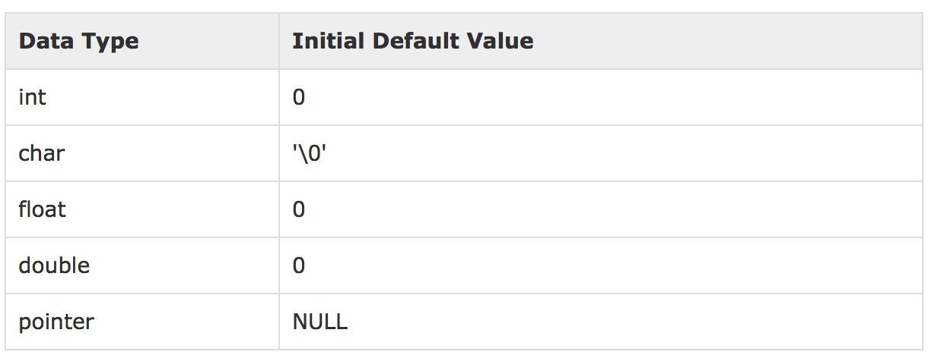
Scope
Initial default value:
Local variables: not need initialize default value (depends on compiler)
Function parameters: from function call
Global variables: based on table below
Notes:
27

Slide 28
Operators and Expressions
Operators
Arithmetic operators
Logic operators
Bitwise operators
Assignment operators
Other operators
Notes:
28

Slide 29
Operators and Expressions Operators
Symbol | Meaning | Data type | Example
+ | Addition | Numeric | x + y
- | Subtraction | Numeric | x - y
* | Multiplication | Numeric | x * y
/ | Division | Numeric | x / y
% | Remainder | Integer or enum type | n % 2
++ | Increment | Numeric | ++x; y++
-- | Decrement | Numeric | --x; y--
Notes:
29

Slide 30
Operators and Expressions Operators
Increment ++
Pre-increment:
Example: (++x – y)
Increment x by 1
Use new value of x in the expression
If x = 4 and y = 5
(++x – y) will be: 0
Post-increment: x++
Example: (x++ – y)
Use current value of x in the expression
Increment x by 1
If x = 4 and y = 5
(x++ – y) will be: -1
In both examples: the final value of x will be 5
Notes:
30

Slide 31
Operators and Expressions Operators
Decrement --
Similar to increment
When do we use ++ and – ?
When we need a variable to control the loop (for, while and do…while)
Notes:
31

Slide 32
Operators and Expressions Logic Operators
Symbol | Meaning | Data type | Example
== | Check equality | Numeric | a == b
!= | Check inequality | Numeric | a != b
> | Larger than | Numeric | a > b
< | Smaller than | Numeric | a < b
>= | Larger or equal | Numeric | a >= b
<= | Smaller or equal | Numeric | a <= b
&& | AND | Logic | b1 && b2
|| | OR | Logic | b1 || b2
! | NOT | Logic | !flag
Notes:
32

Slide 33
Operators and Expressions Bitwise Operators
Symbol | Meaning | Data type | Example
& | Bitwise AND | Numeric | a & PATTERN
| | Bitwise inclusive OR | Numeric | a | PATTERN
^ | Bitwise exclusive XOR | Numeric | a ^ b
~ | One’s complement | Numeric | ~a
<< | Left shift | Numeric | a << 2
>> | Right shift | Numeric | a >> 2
Notes:
33

Slide 34
Operators and Expressions Assignment Operators
Symbol | Meaning | Data type | Example
= | Assign A = B | All | a = (b + c )*f
+= | A = A+B | Numeric | a += 2
-= | A = A-B | Numeric | a -= 2
*= | A = A*B | Numeric | a *= 2
/= | A = A/B | Numeric | a /= 2
%= | A = A%B | Integer | a %= 2
<<= | A = A << B | Numeric | a <<= 2
>>= | A = A >> B | Numeric | a >>= 2
&= | A = A & B | Numeric | a &= 2
^= | A = A ^ B | Numeric | a ^= 2
|= | A = A | B | Numeric | a |= 2
Notes:
34

Slide 35
Operators and Expressions Other Operators
Symbol | Meaning | Data type
sizeof() | Returns the size (bytes) of a type or a variable | Fundamental data type
& | Returns the address of the memory named Variable | All
* | Returns the value of the memory Pointer points to | All
? : | Conditional operator | (C? A: B) C: Logic expression A, B: expression
[] | Returns the element at the index | Any data type
Notes:
35

Slide 36
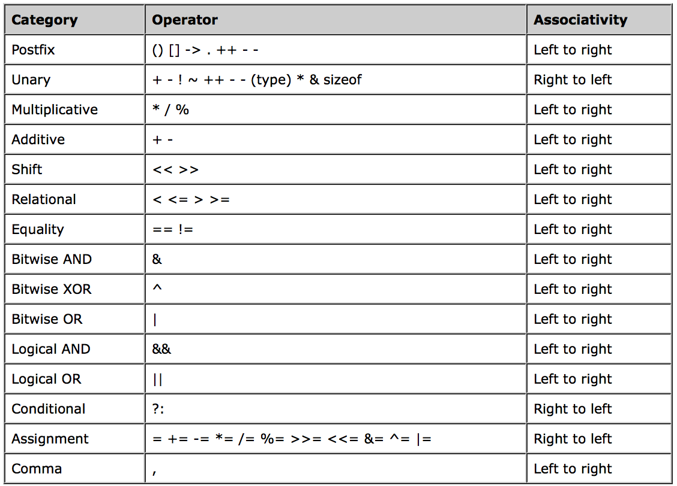
Operators and Expressions Priority of Expression
Notes:
36

Slide 37
Operators and Expressions
Arithmetic Operators
Further reading: http://www.tutorialspoint.com/ansi_c/c_operator_types.htm
Notes:
37

Slide 38
Operators and Expressions
Expression
Contain operators and operands
Expression: X + Y
X, Y: Operands
+ : Operator
Addition operator
Expression: ! (A && B)
(A && B): AND operator
! : not
&&: Logic operator
The result data type of operation depends on the data types of the operands
Notes:
38

Slide 39
Operators and Expressions
Expression
Operands can be constants
Notes:
39
39

Slide 40
Enum Data Type
Why do we need enum ?
In program, a constant (1, 2 or 3,…) should be used to represent:
A set of choices
A month in a year
A color
...
To increase code quality (read / understand / maintain), a collection of constants should be grouped together and be used by a name to represent the meaning of this group. In this case, enum type should be used.
Notes:
40

Slide 41
Enum Data Type
Example:
(1) Color set:
enum colors {RED, GREEN, BLUE};
(2) Months set:
enum months {JAN, FEB, MAR, APR, MAY, JUN, JUL, AUG, SEP, OCT, NOV, DEC};
(3) Choices set:
enum user_choices {LOAD_DATA, INPUT_DATA, PRINT_DATA};
Notes:
41

Slide 42
Enum Data Type
What is enum ?
Is a data type
In previous example, we have 3 enum type: colors, months, user_choices.
A variable with colors enum type can only be RED, GREEN or BLUE
A variable with months enum type can only be JAN, FEB, MAR, etc.
A variable with user_choices enum type can only be LOAD_DATA, INPUT_DATA, etc.
Notes:
42

Slide 43
Enum Data Type
What is enum?
A collection of constants
In previous example, we have collections of constants: colors, months, user_choices.
Colors has constants: RED, GREEN, BLUE
Months has constants: JAN, FEB, MAR, v.v.
User_choices has constants: LOAD_DATA, INPUT_DATA, v.v.
The list of values in enum type are assigned a number automatically. The first constant assigned to 0, the second constant assigned to 1, and so on.
However, programmer can define the value assigned to constants in the collection, should be the first only.
enum colors {RED = 10, GREEN, BLUE};
Notes:
43

Slide 44
Enum Data Type
Declare and use enum type
#include <iostream>
using namespace std;
int main(){
enum colors {RED, GREEN, BLUE};
colors b = BLUE, c = GREEN;
cout << "b= " << b << endl;
cout << "c= " << c << endl;
system("pause");
return 0;
}
Result on console:
b = 2
c = 1
Why ?
Notes:
44

Slide 45
Enum Data Type
How to print name of all constants in enum type ?
#include <iostream>
using namespace std;
int main(){
enum colors {RED, GREEN, BLUE};
char* colors_names[] = {"RED", "GREEN", "BLUE"};
colors b = BLUE, c = GREEN;
cout << "b= " << colors_names[b – RED] << endl;
cout << "b= " << colors_names[c – RED] << endl;
system("pause");
return 0;
}
Notes:
45

Slide 46
Constant Definition
What is constant ?
Refer to fixed values that the program can not alter during its execution.
So,
The value of constant must be determined at compile time
Example
(1) Use const keyword
const int MAX = 50;
(2) Use macro
#define MAX 50
(3) Use enum
enum {MAX};
enum {MAX = 50};
Notes:
46

Slide 47
Constant Definition
Example
Char constant
const char c = ‘a’;
const char c = ‘A’;
String constant
const char c[] = “LAP TRINH C/C++”;
const char c[] = “SAI GON”;
Other type constant
const int a = 100;
const float f = 10.5f;
const double d = 10.5;
Notes:
47

Slide 48
Type Casting
What is type casting ?
When we assign a value to a variable with the same data type, or operator between two operands with the same data type, there is no type conversion.
Example
int a = 100;
int b;
b = a;
float f = 10.5f;
float fa;
fa = f;
Notes:
48
48

Slide 49
Type Casting
What is type casting ?
But, how can we convert a variable from one data type to another data type ?
Example:
short a = 100;
Int b;
b = a;
double d = 10.5;
float fa;
fa = d;
=> convert the values from one type to another type implicitly (short to int or double to float)
Notes:
49
49

Slide 50
Type Casting
Type casting operator, in the following forms
(type) expression
type(expression)
Two cases:
Promotion: smaller to bigger size
Truncation: bigger size to smaller size
char < short < int < long < float < double < long double
promotion
truncation
Notes:
50
50

Slide 51
Type Casting
Implicit type conversion
Is an automatic type conversion by the compiler.
Example:
short s = 100;
int a = s; // value will be changed
Variable a with type “int” is destination data type
Variable s with type “short” is source data type
“short” similar to “int” so compiler convert type automatically without error
Notes:
51
51

Slide 52
Type Casting
Implicit type conversion
Unchanged source value
When source data type has fewer bits than destination data type
Example
char to short
short to int
Int to long long
Int to double
Notes:
52
52

Slide 53
Type Casting
Implicit type conversion
Unchanged source value
Changed source value
unsigned to signed | signed to unsigned
Use two’s complement rule
Two’s complement = one’s complement + 1
One’s complement = (0 → 1, 1 → 0)
Logic to number:
true → 1
false → 0
Number to logic
Khác 0 → true
Bằng 0 → false
Notes:
53
53

Slide 54
Type Casting
Implicit type conversion
Unchanged source value
Changed source value
unsigned to signed | signed to unsigned
Logic to number
Number to logic
float or double to integer (char, short, int, v.v)
Fractional part will be cut (2.456 → 2)
If integral part is out of range of destination data type then nothing will be known ! (based on compiler)
Notes:
54
54

Slide 55
Type Casting
Explicit type conversion
Is special programming instruction which specifies what data type (decided by programmer) to treat a variable in a given expression.
How to use ?
Functional notation
double x = 10.5;
int a = int(x);
C-like cast notation
double x = 10.5;
int a = (int) x;
Example
Find values of x and y in the following example
Notes:
55
55

Slide 56
Type Casting
Type casting
#include <iostream>
#include <iomanip>
using namespace std;
int main(){
double x = 3/2;
double y = (double)3/2;
cout << "x = ", << setw(4) << setprecision(2) << x << endl;
cout << "y = ", << setw(4) << setprecision(2) << y << endl;
system("pause");
return 0;
}
Notes:
56
56

Slide 57
Type Casting
Type casting
Example
Find values of a and b and result on the console in the following example
Notes:
57
57

Slide 58
Type Casting
Type casting
#include <iostream>
#include <iomanip>
using namespace std;
int main(){
unsigned char a;
signed char b;
a = -1;
b = 255;
cout << "a= " << static_cast<unsigned>(a) << endl;
cout << "b= " << static_cast<unsigned>(b) << endl;
cout << "a < 5 is "; a < 5 ? cout << "true \n": cout << "false \n";
cout << "b > 5 is "; b > 5 ? cout << "true \n": cout << "false \n";
system("pause");
return 0;
}
Notes:
58
58

Slide 59
Exercises
Notes:
59
59

Slide 60
Summary
How to handle data in a C++ program
Data types
Built-in: char, int, float, double, …, void
Derived: array, pointer, structure, union, enum
enum and structure for abstract data
More advanced types (array, pointer) come later.
Variables: declaration vs. definition
Naming
Type
Value
Scope
Notes:
60

Slide 61
Summary
Constants
No change during the execution of the program
Known at the compile time
Defined with: #define, enum, const
Expressions
Operators
Assignment
Arithmetic
Bitwise
Logic
Relational and others
Type casting: explicit vs. implicit conversion
Notes:
61

